Slide 1
VEHICLE INCIDENT MANAGEMENT DATABASE SYSTEM
PRESENTED BY:
PRAVEEN KUMAR
ANIRUDH RAJ
ROHIT GUNELLY
PRANAV THORALI
SIQI YAO

Slide 2
OBJECTIVE
To develop an integrated incident management database system that leverages IoT-enabled vehicle data to process real-time incident tracking and assist in streamlining service workflows in insurance claims, service history logging, compliance support and user-dealership relations

Slide 3
SCOPE AND MOTIVATION
The efficiency of our model has a direct impact on the brand image of an automotive company as data collected on incidents can imply:
Upgrades on vehicular components that could be based off of past rectified incidents.
The quality of service provided to rectify it that a user can expect upon buying a vehicle.
Reliable incident data that can be used to negotiate better insurance premiums for customers.
Coordination between dealerships, repair teams, and customers to reduce downtime and reinforcing reliability
Mainly real-time dynamic incident resolution through IOT device location tracking

Slide 4
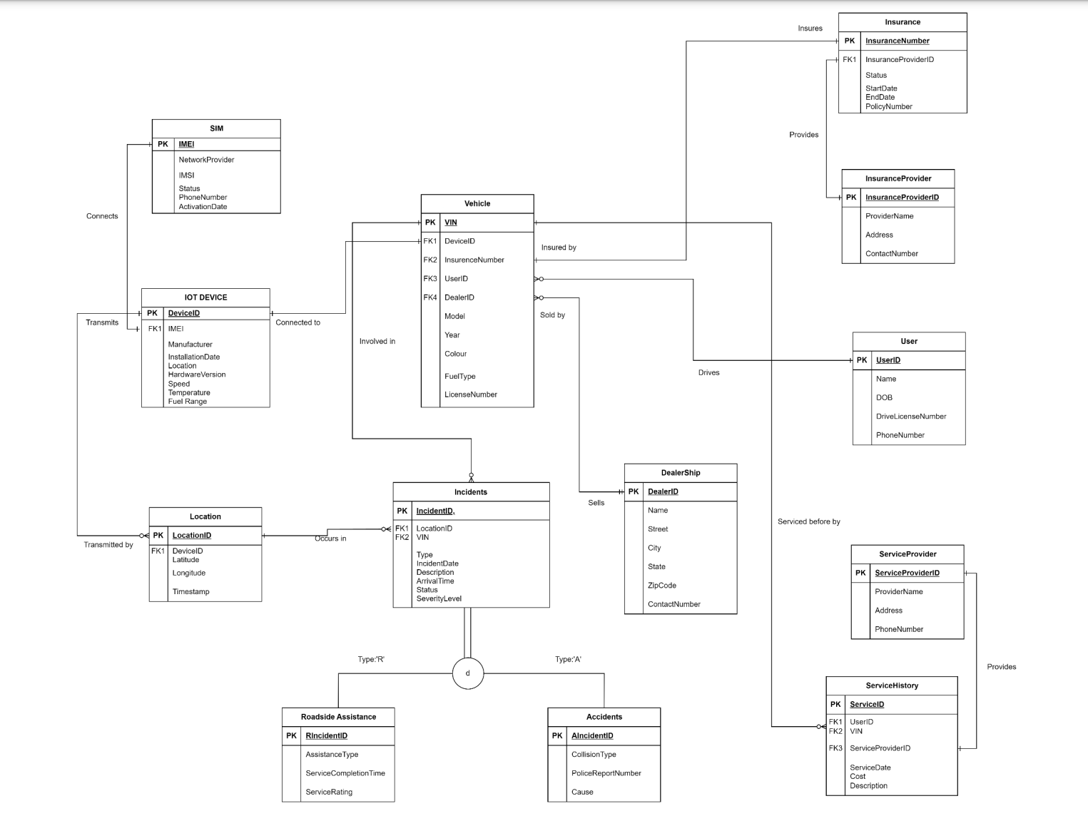

Slide 5
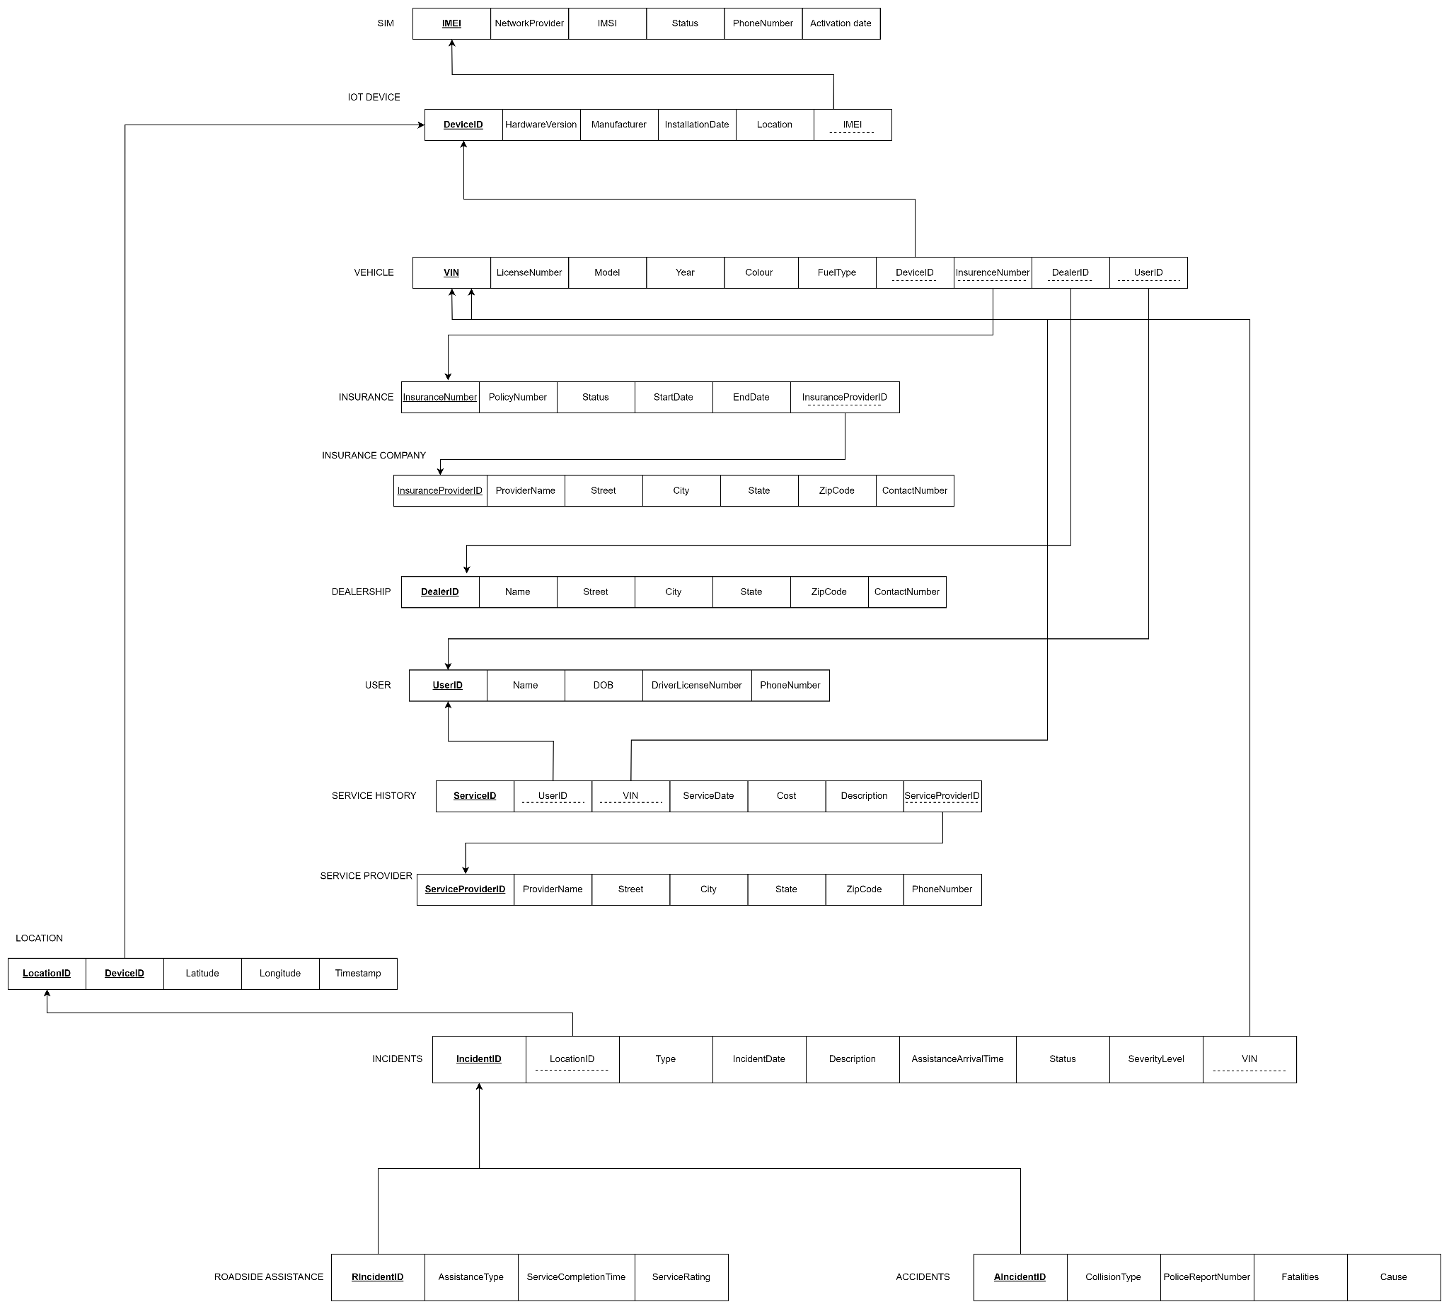

Slide 6
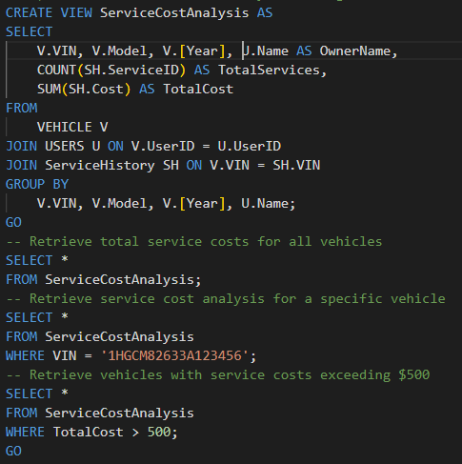
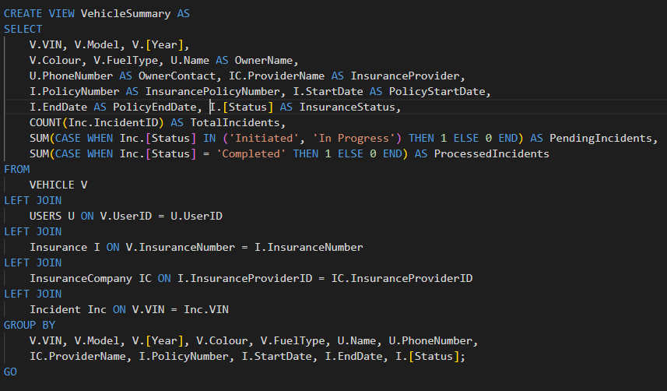
KEY VIEWS
VIEW TO GENERATE VEHICLE SUMMARY THAT INCLUDES OWNERS, INSURANCE DETAILS AND ACTIVE/RECTIFIED INCIDENTS
VIEW TO DISPLAY SERVICE COST OF A VEHICLE

Slide 7


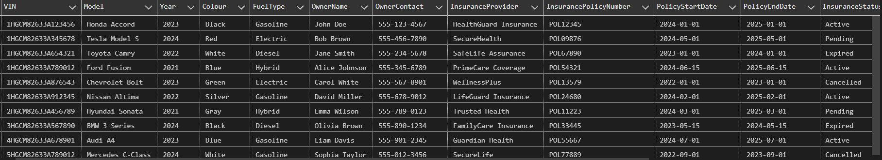
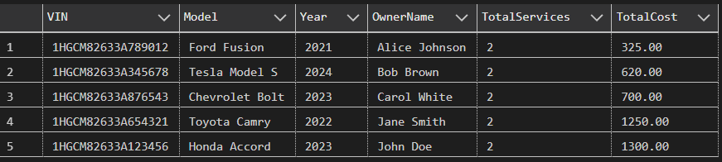
OUTPUT DEMO

Slide 8
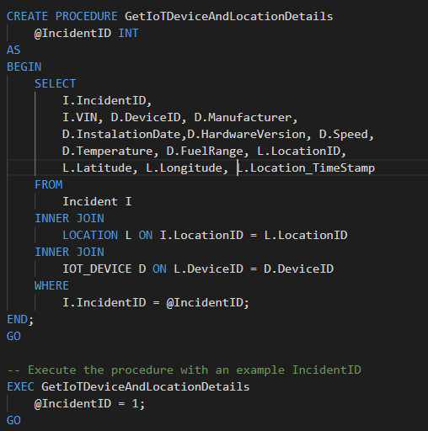
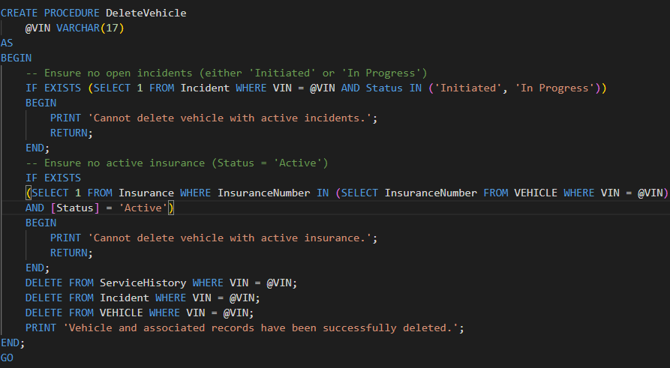
KEY STORED PROCEDURES
TO DISPLAY IOT DEVICE AND LOCATION DETAILS BASED OFF OF INCIDENTS
PROCEDURE TO DELETE VEHICLE AFTER CHECKING FOR ACTIVE INSURANCE OR INCIDENTS

Slide 9
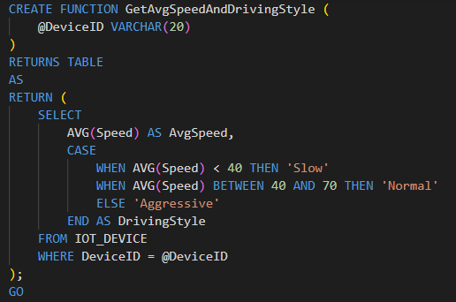
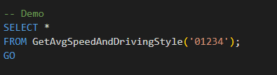

KEY USER DEFINED FUNCTIONS
FUNCTION TO DETERMINE DRIVING STYLE BASED ON IOT METRICS FOR INSURANCE CLAIMS PROCESSING

Slide 10
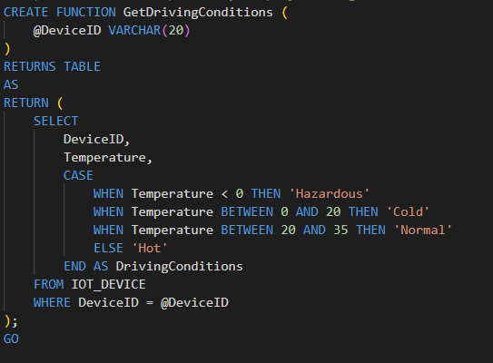
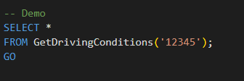

KEY USER DEFINED FUNCTIONS
FUNCTION TO PRESUME DRIVING CONDITIONS BASED ON ENGINE TEMPERATURE METRIC FROM IOT DEVICE

Slide 11
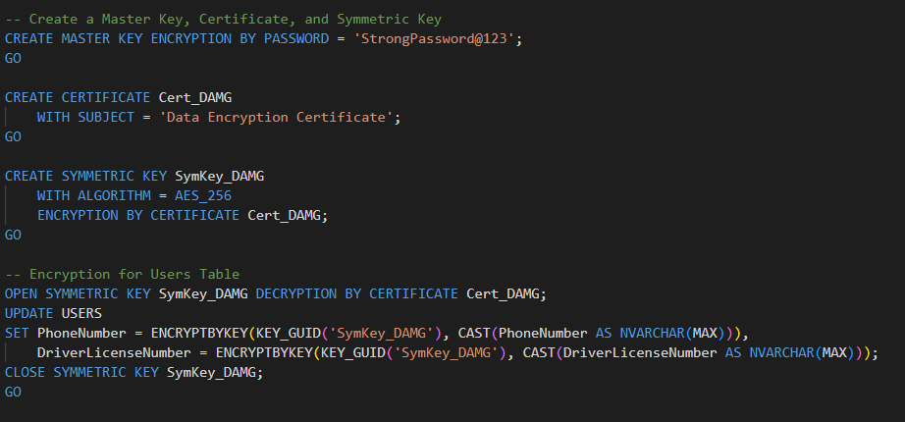
ENCRYPTED FIELDS
ALL LICENSE NUMBERS AND PHONE NUMBERS ASSOCIATED WITH USERS, SERVICE AND INSURANCE PROVIDERS, DEALERSHIP COMPANY DETAILS AND VEHICLES ARE ENCRYPTED BY AES 256

Slide 12
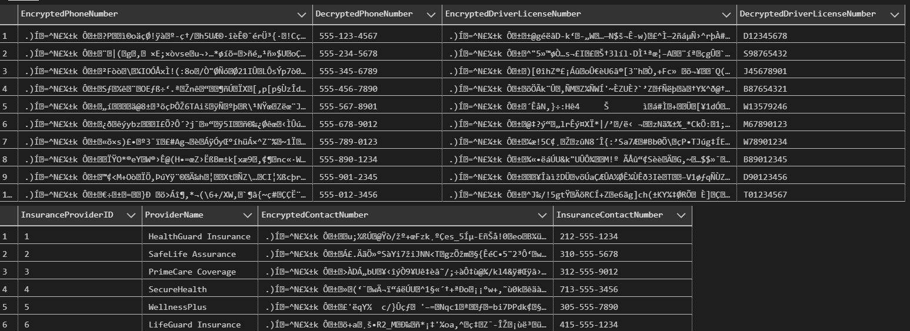
OUTPUT DEMO

Slide 13
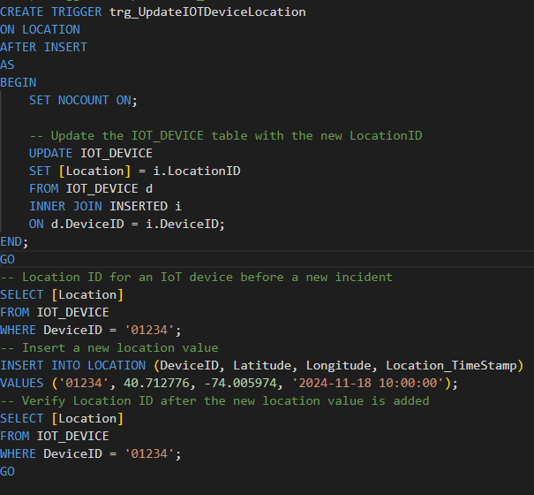
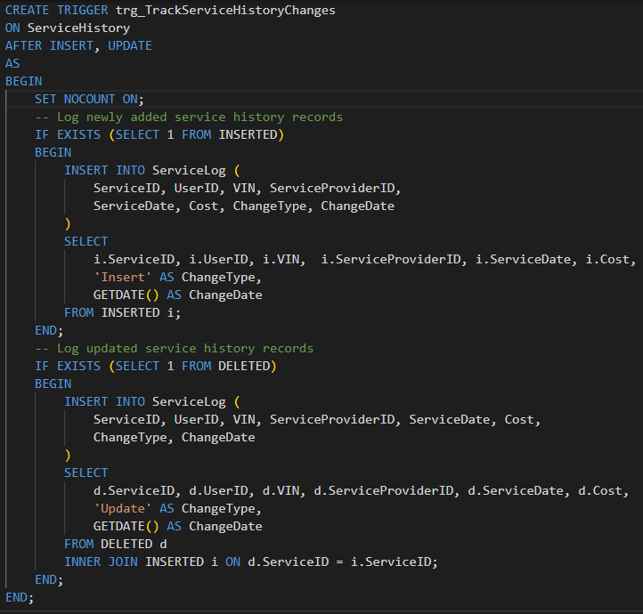
TRIGGERS
TO UPDATE IOT DEVICE UPON NEW LOCATION DATA
TO LOG SERVICE HISTORY UPDATES FOR VEHICLES

Slide 14
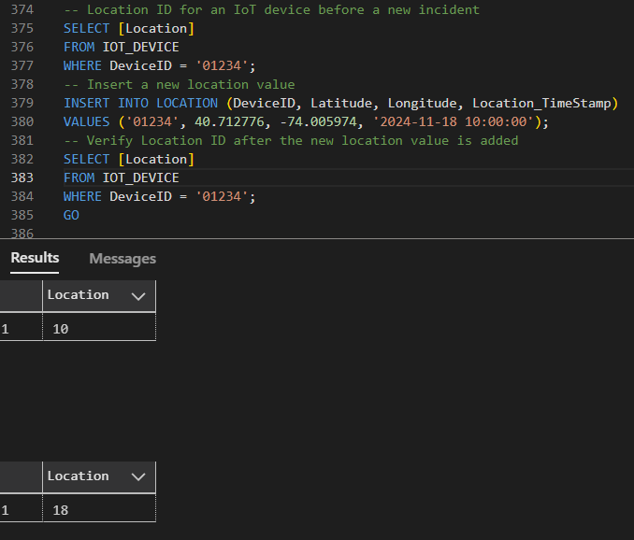
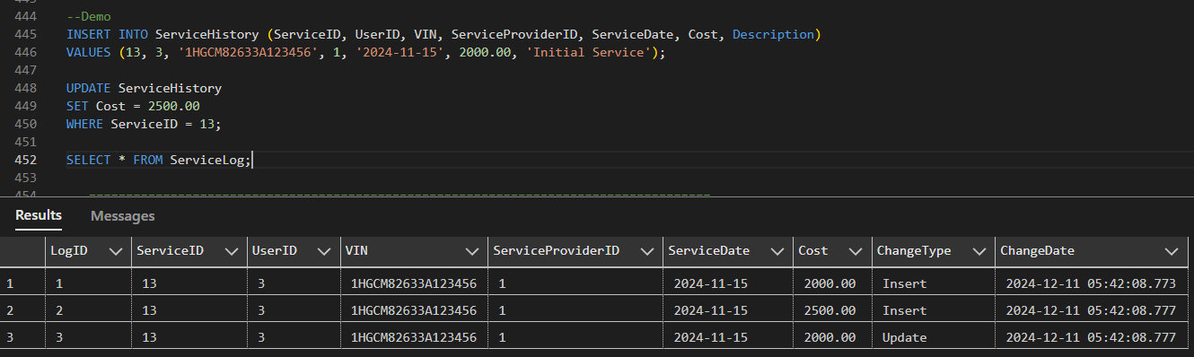
OUTPUT DEMO

Slide 15
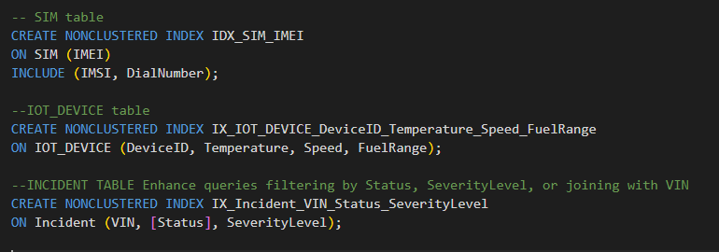
NON CLUSTERED INDEXES:
Frequently queried columns such as IMEI under the SIM relation, IOT device metrics and status and severity level under the INCIDENT relation are indexed for better performance

Slide 16
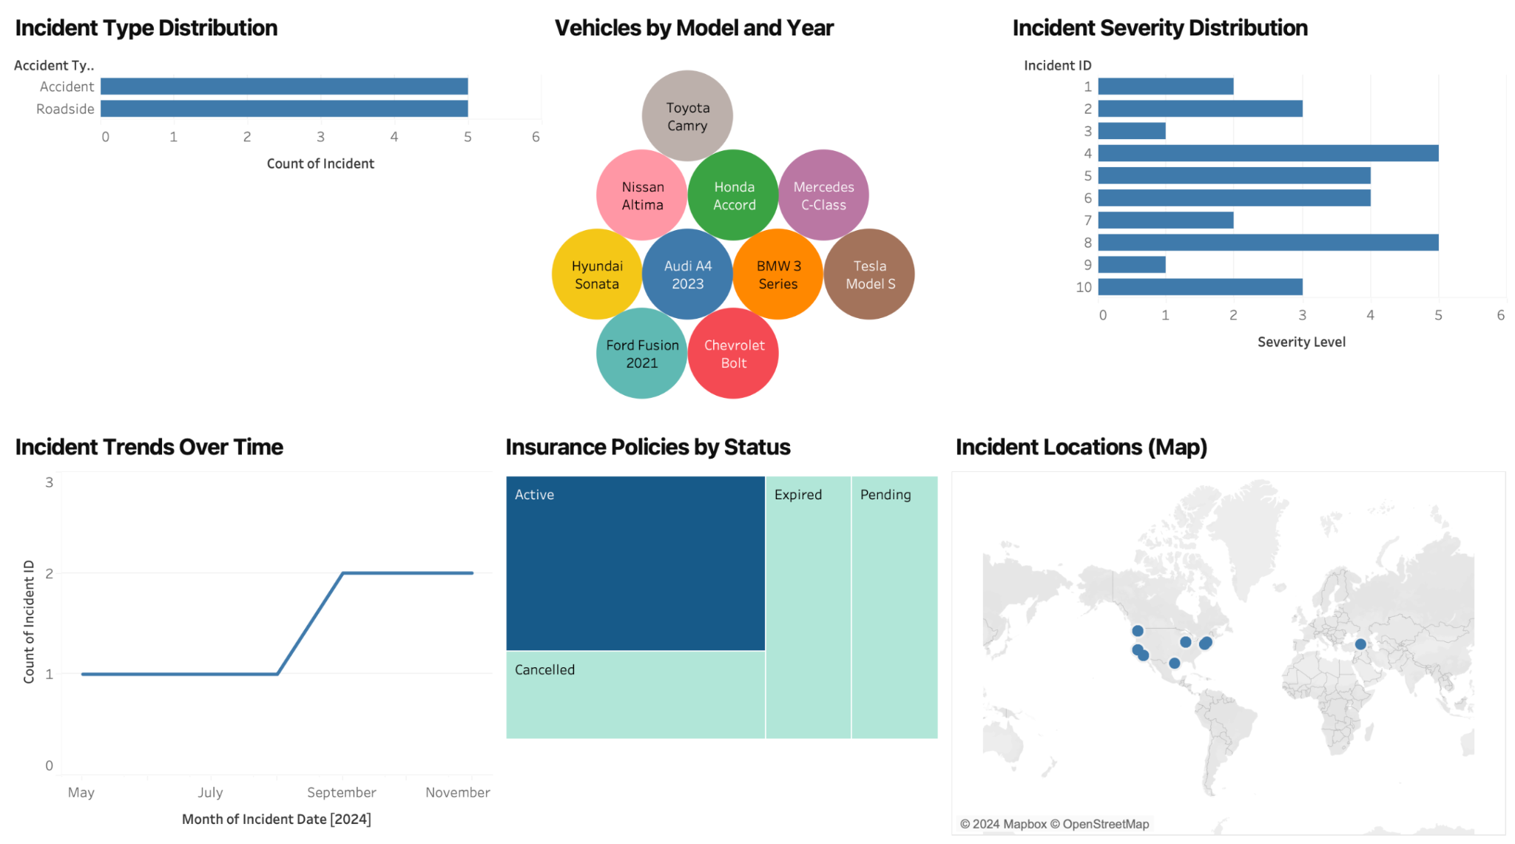
DATA INSIGHTS VISUALIZED ON TABLEAU

Slide 17
THANK YOU

